Slide 1
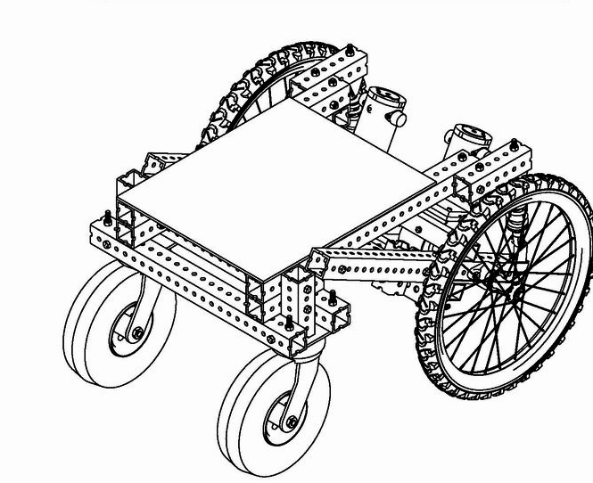
UGV Design

Slide 2
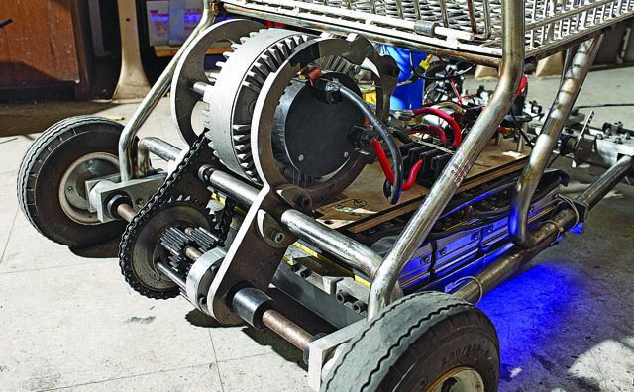
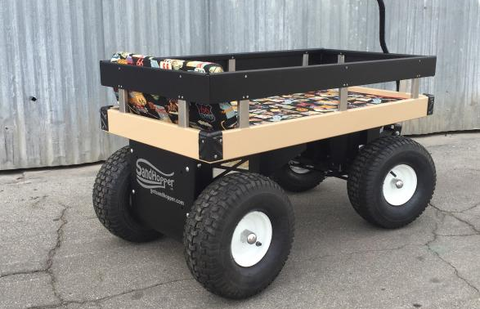
Why design the frame from scratch?
Using an existing base will require require a lot of modification
Modified Shopping cart
Modified Trolley

Slide 3
Why design the frame from scratch? (Continued)
The effort required to make modifications will approximately be the same designing the frame from scratch
More freedom in the design process
Flexibility to add components/features later down the line
Making the frame from scratch would assure 100% reproducibility

Slide 4
Components and Budget (Rough Calculation)
 | Item | Quantity | Price per item (Rs)
1 | Hub Wheel Motor + Motor Controller | 4 | 12,000
2 | Car Frame | 1 | 20,000
3 | Battery | 1 | 14,000
4 | Arduino Mega | 1 | 1200
 |  |  | Total = 83200

Slide 5
Project Division
The project will be divided in a total of 5 parts
Milestone 1
Milestone 2
Milestone 3
Milestone 4
Milestone 5
Design and Fabrication of the car
Configuring the electronics
Implementing low level control
Fine tuning the motion
Implementation of high level algorithms
CAD design
Stress Analysis
Frame Assembly
Fitting the motors
Setting up power supply
Configuring the motor controllers
Designing the circuits as needed
Making a low level API for the control
Establishing tethered control
Establishing untethered control
Establishing RC control
Applying a pid loop to achieve precise motion
Applying Sensor fusion techniques to combine and extract the relevant data from the sensors
Computer Vision
Slam
Synchronization with a drone for a complex task

Slide 6
Timeline
Milestones 1-4 will take up a total of 2 months
 | Description | Duration
Milestone 1 | Designing and Fabrication | 1 month
Milestone 2 | Configuring the Electronics | 10 Days
Milestone 3 | Implementation of Low level control | 10 days
Milestone 4 | Fine tuning of motion | 10 days

Slide 7
Is the project feasible in my opinion?
The project is achievable within a span of 2 months given the availability of
Relevant Manpower
Relevant tools
Components

